Slide 1
2014 CYAC Summer
Arduino Course
Lecture 03
LCD module
吳振豪

Slide 2
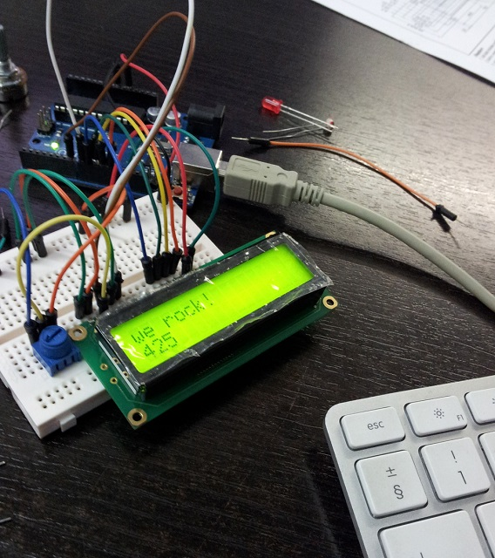

Slide 3
The ways we display information
How many ways can exchange information by visual
To see Practice 1

Slide 4
Take note

Slide 5
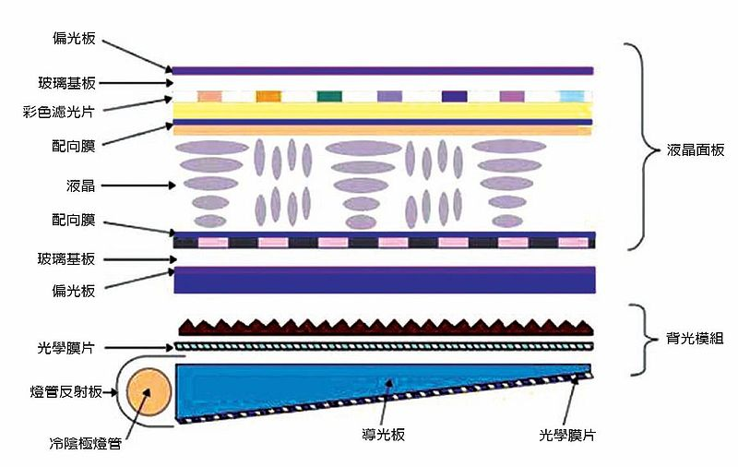
About LCD
Structure (wiki)

Slide 6
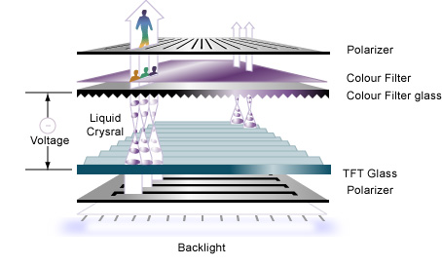
Principle

Slide 7
Text LCD module
What is the text LCD?

Slide 9
Practice
Please write at least one method to display information

